Slide 1

Amazon FireTV Stick Reviews Sentiment
Project Mentor: Varun Vennelaganti
Group Members: 1.Omkar Bhagwat
2.Chaitravi Angane
3.Yogita Sharma
4.Akarsh Bhasi
5.Amrut Vishwaroop
6.Nitin Sharma
P-125
Date: 03/06/2022

Slide 2
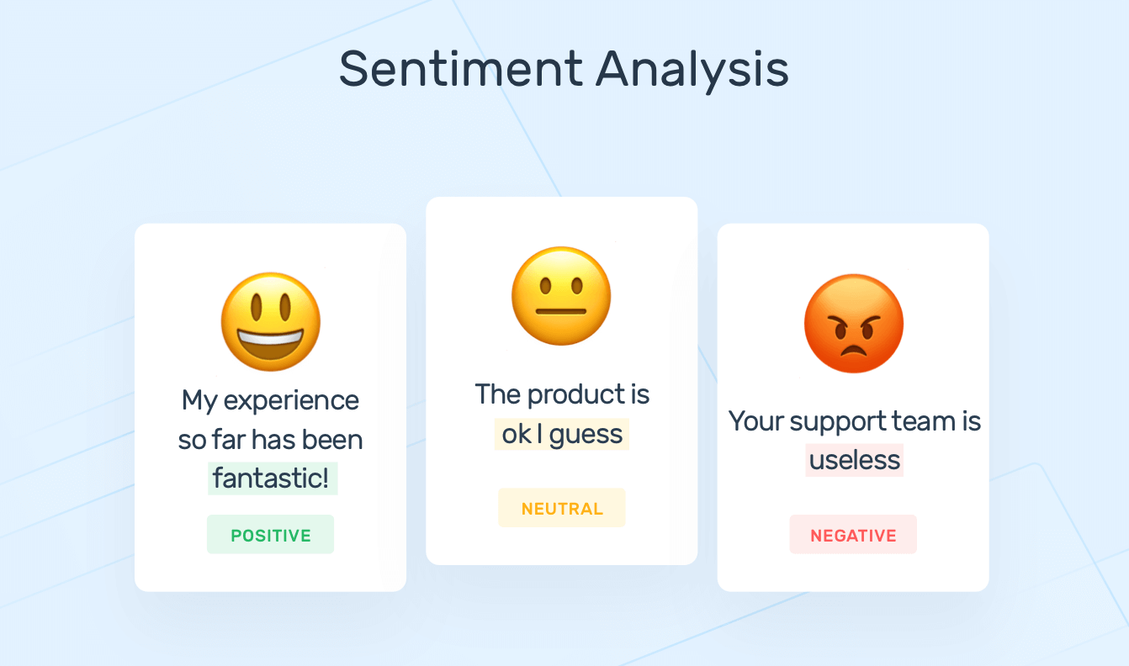
Business Problem:
The goal of sentiment analysis is to know a user opinion on a target object (Product) by analysing a vast amount of data.
In this project we have selected Amazon FireStick as the product, the reason for selection was to analyse the reviews into positive, negative or neutral.
Sentiments :

Slide 3
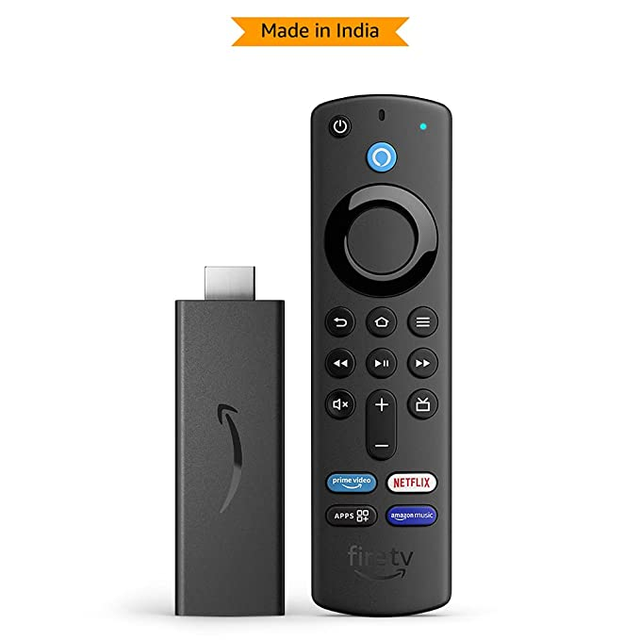

Product description:
Amazon fire Tv stick is a media streaming device which lets to stream video, install apps, play music etc on your tv.
It's built on the Android platform and it converts normal tv to a smart tv.

Slide 4
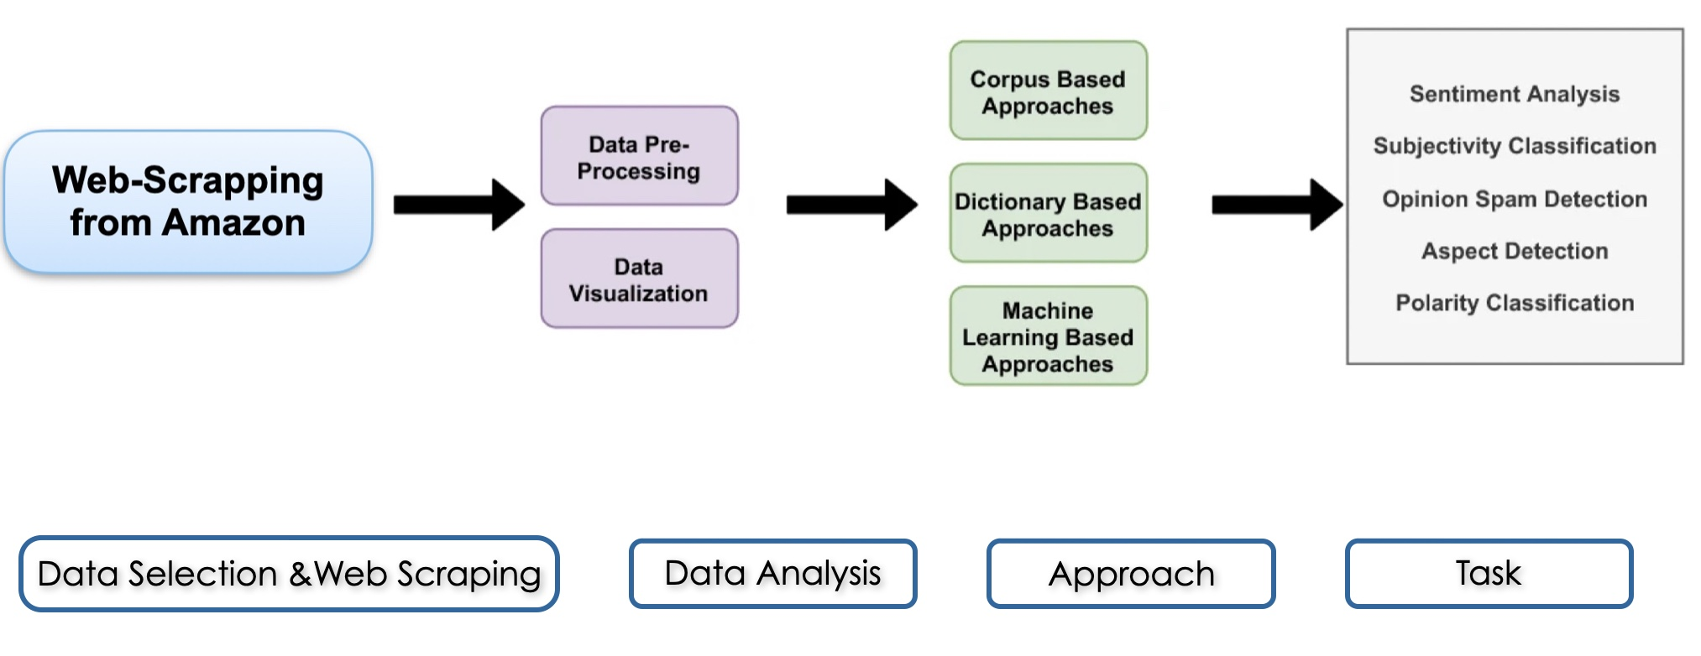
Project Architecture / Project Flow

Slide 5
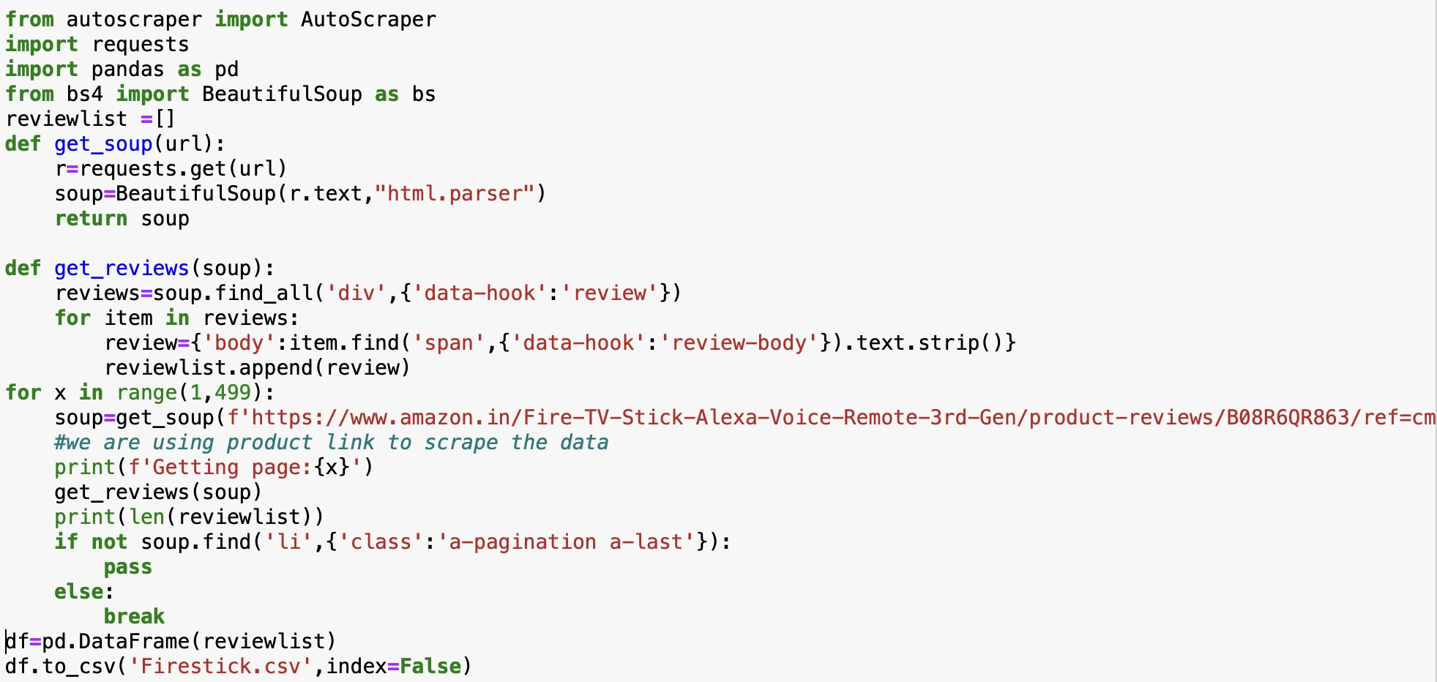
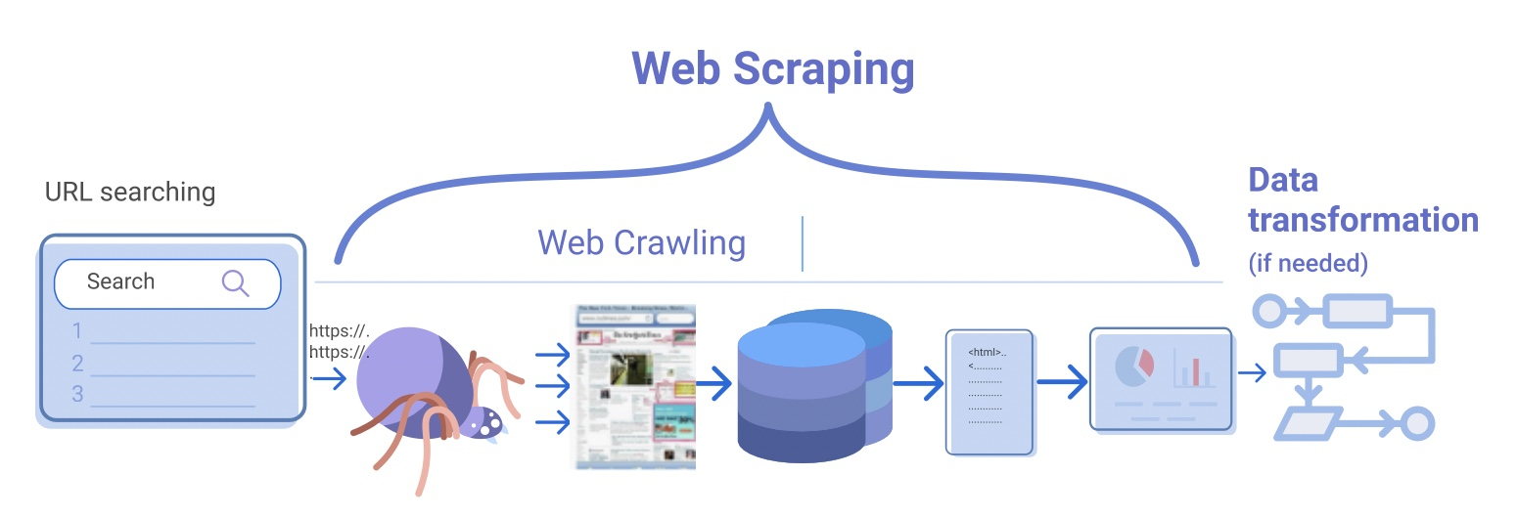
Web scraping:
• Web scraping is the process of extracting content and data from a website.
• Web scraping of the data was carried out with the help of beautiful-soup library.
beautiful-soup

Slide 6
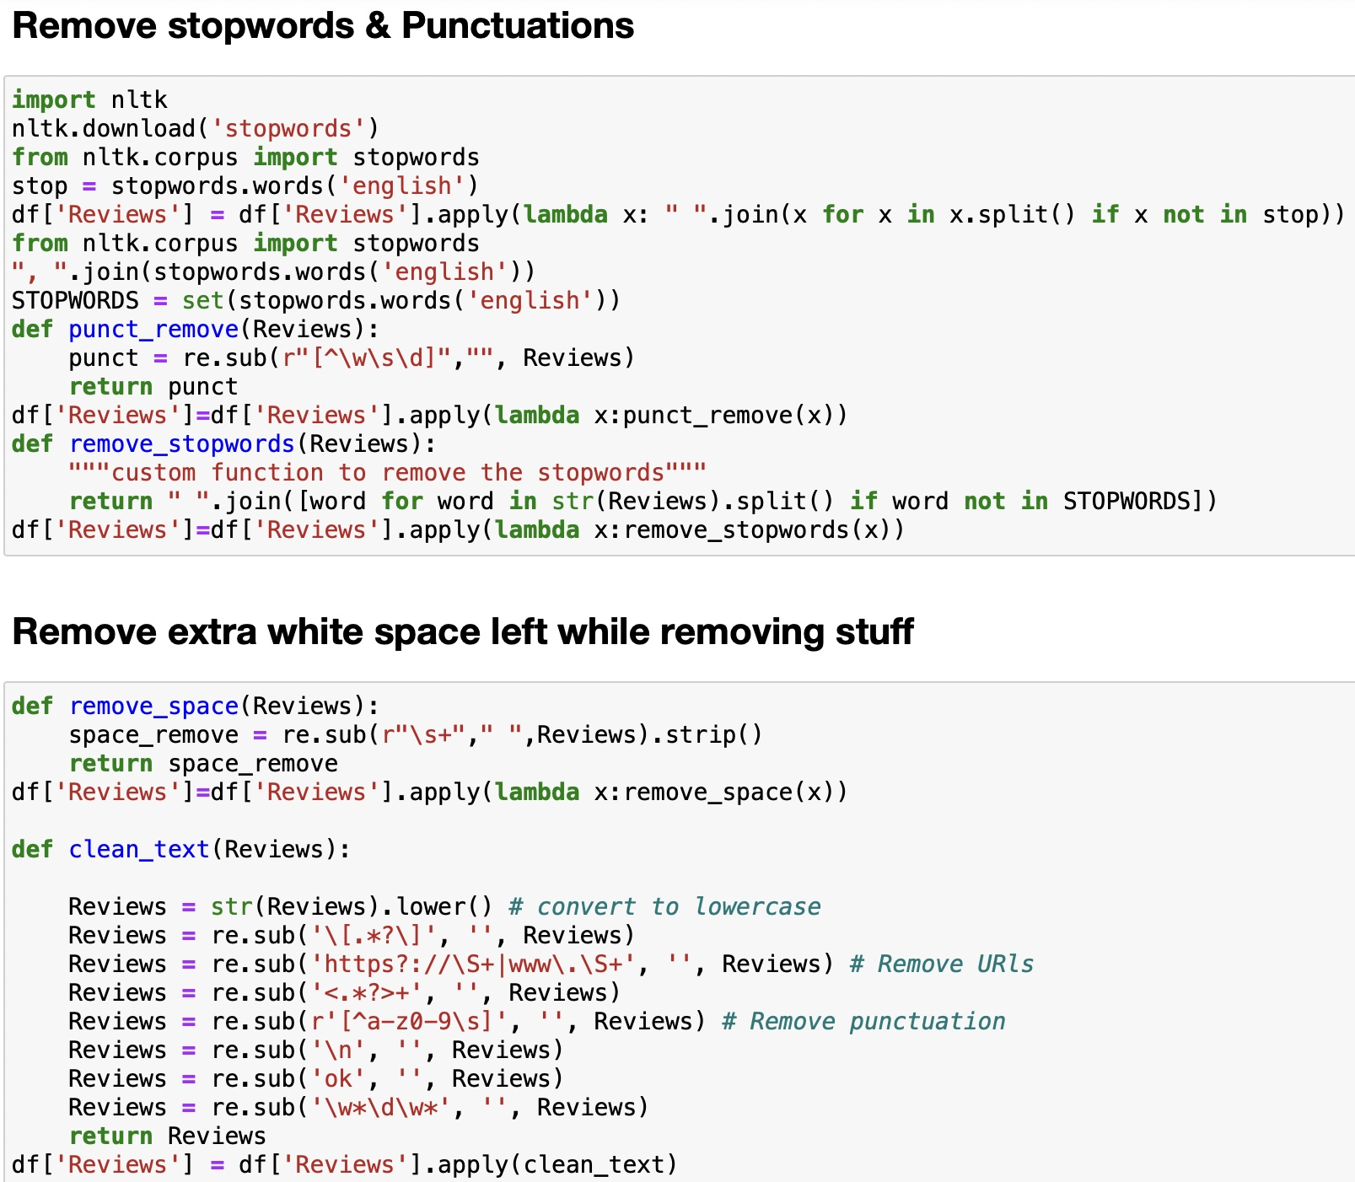
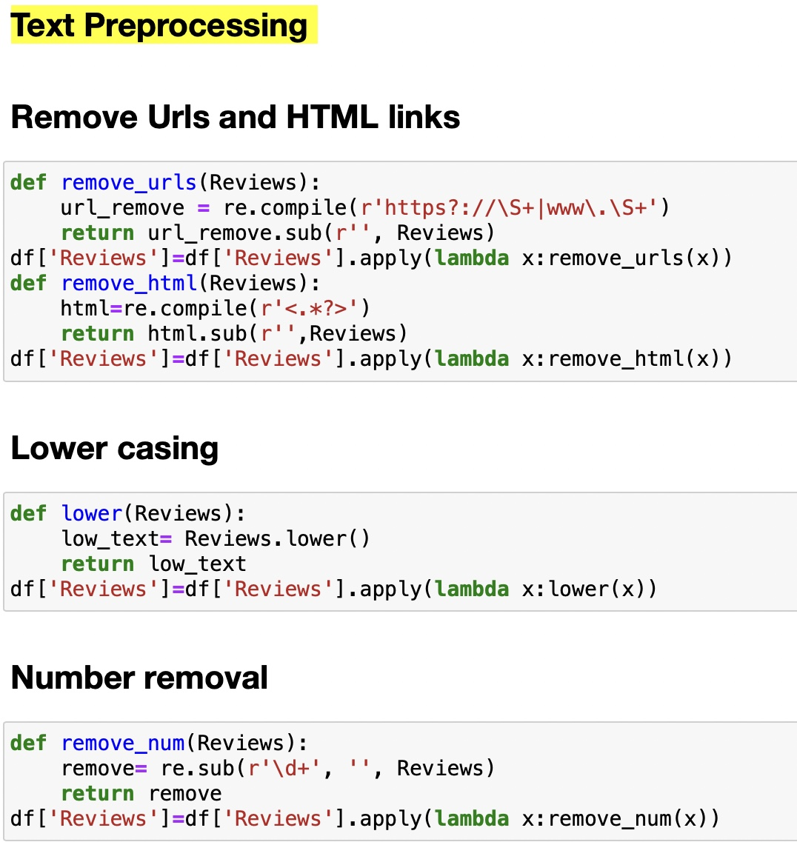
Exploratory Data Analysis (EDA):
Look for problems in the data such as null values, duplicate values etc.
Checking for outliers and removal of outliers.
Cleaning of data like removal of punctuations, urls, html tags, hasgtag, space, etc was carried out.

Slide 7
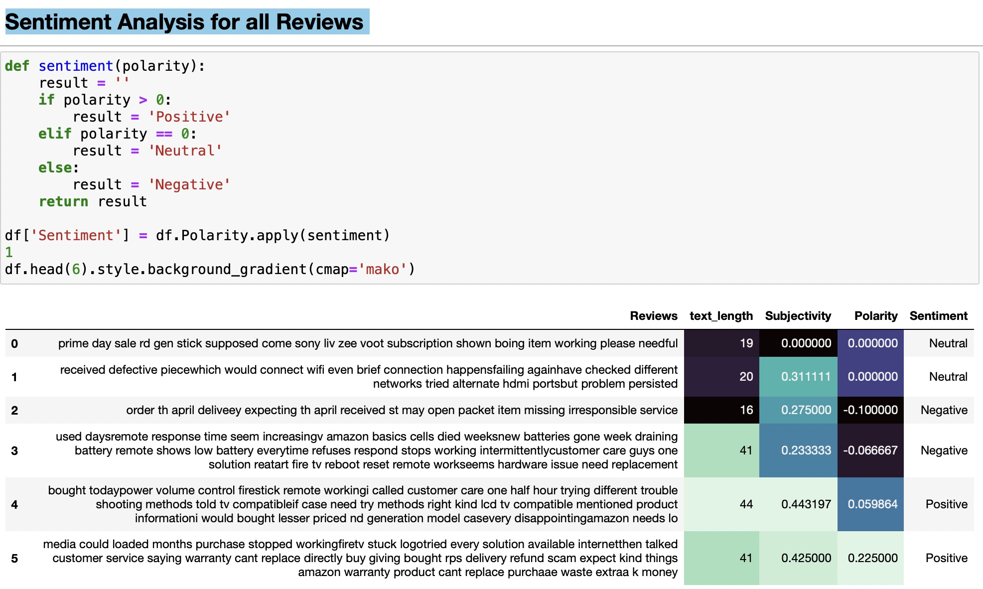
Sentiment prediction:

Slide 8
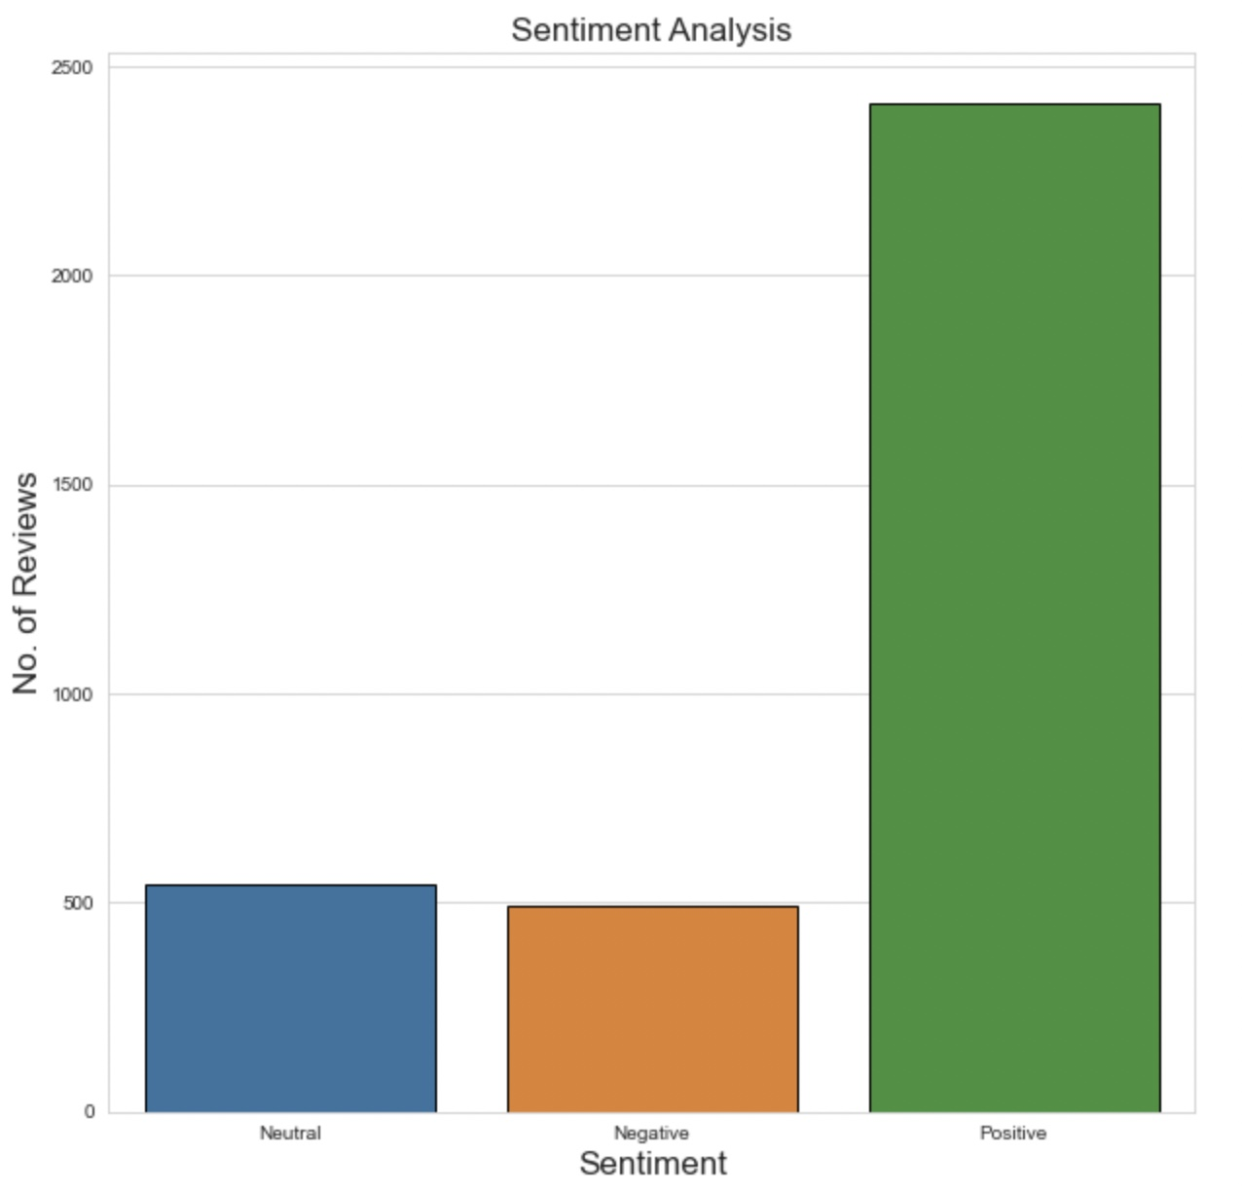
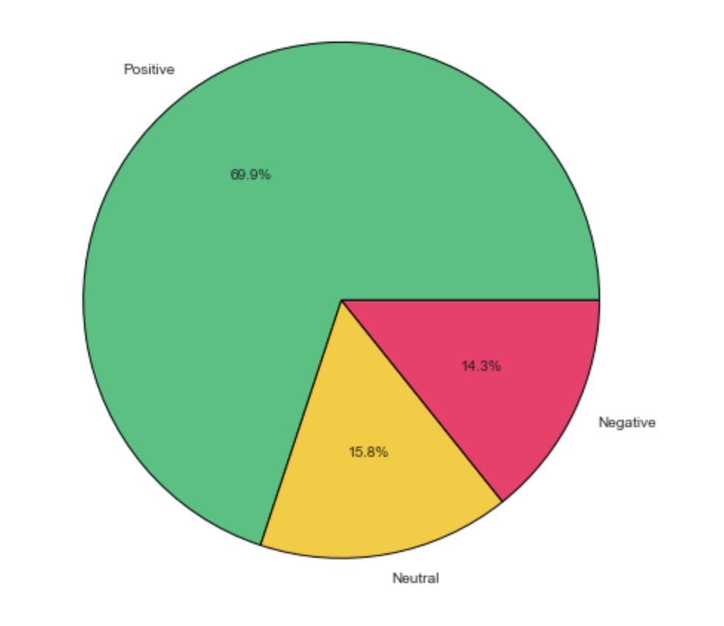
Visualisation:

Slide 9
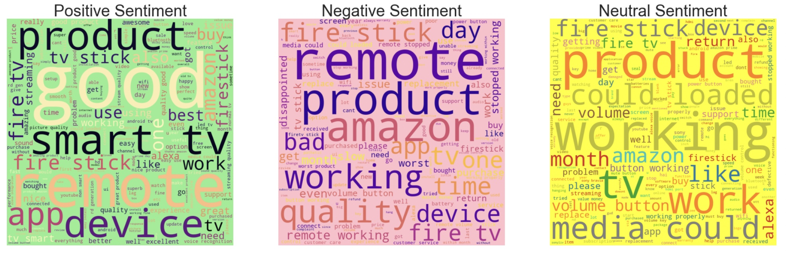
WordCloud:

Slide 10
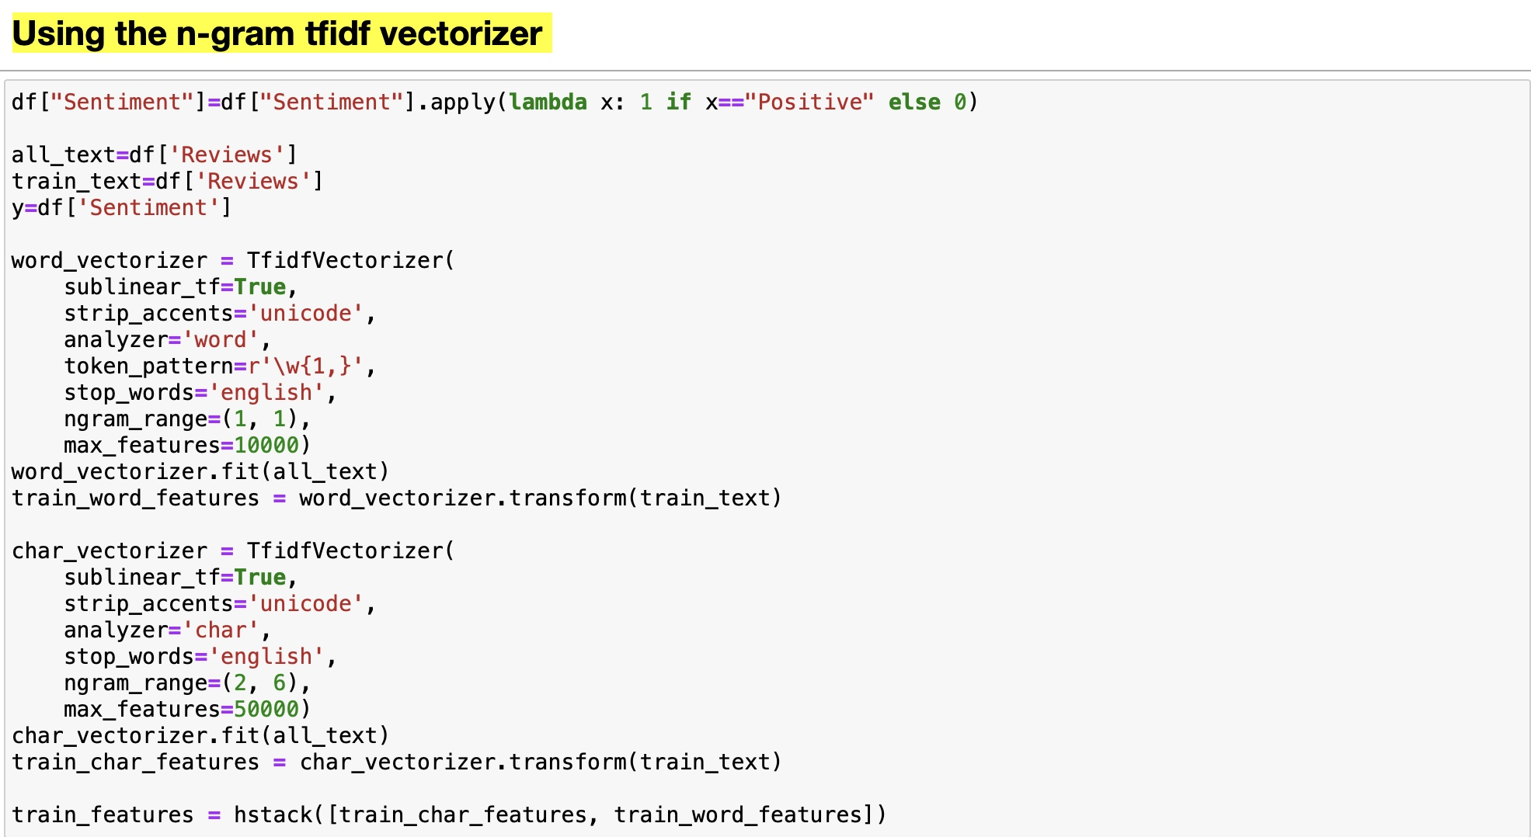
Term Frequency- Inverse Document Frequency:

Slide 11
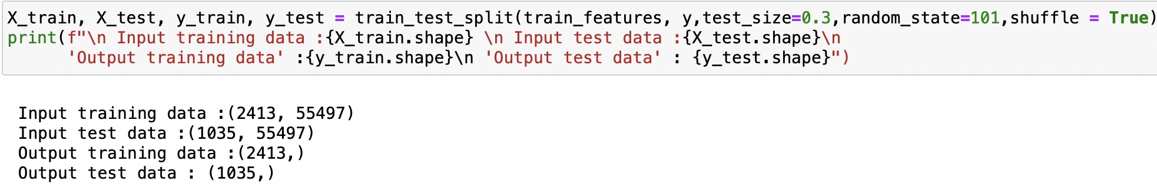

Data Splitting:
The data was split into test and train with the help of test train split in 7:3 ratio.
It indicated 70% of the data was used for training and 30% of the data was used for testing

Slide 12
Diffrent Algorithm:
Logistic regression
Random forest
Neural Network
Ridge Classifier
Gradient boost
XG boost
SVM
Naïve Bayes
Kfold Crossvalidation
Decision Tree Classifier

Slide 13
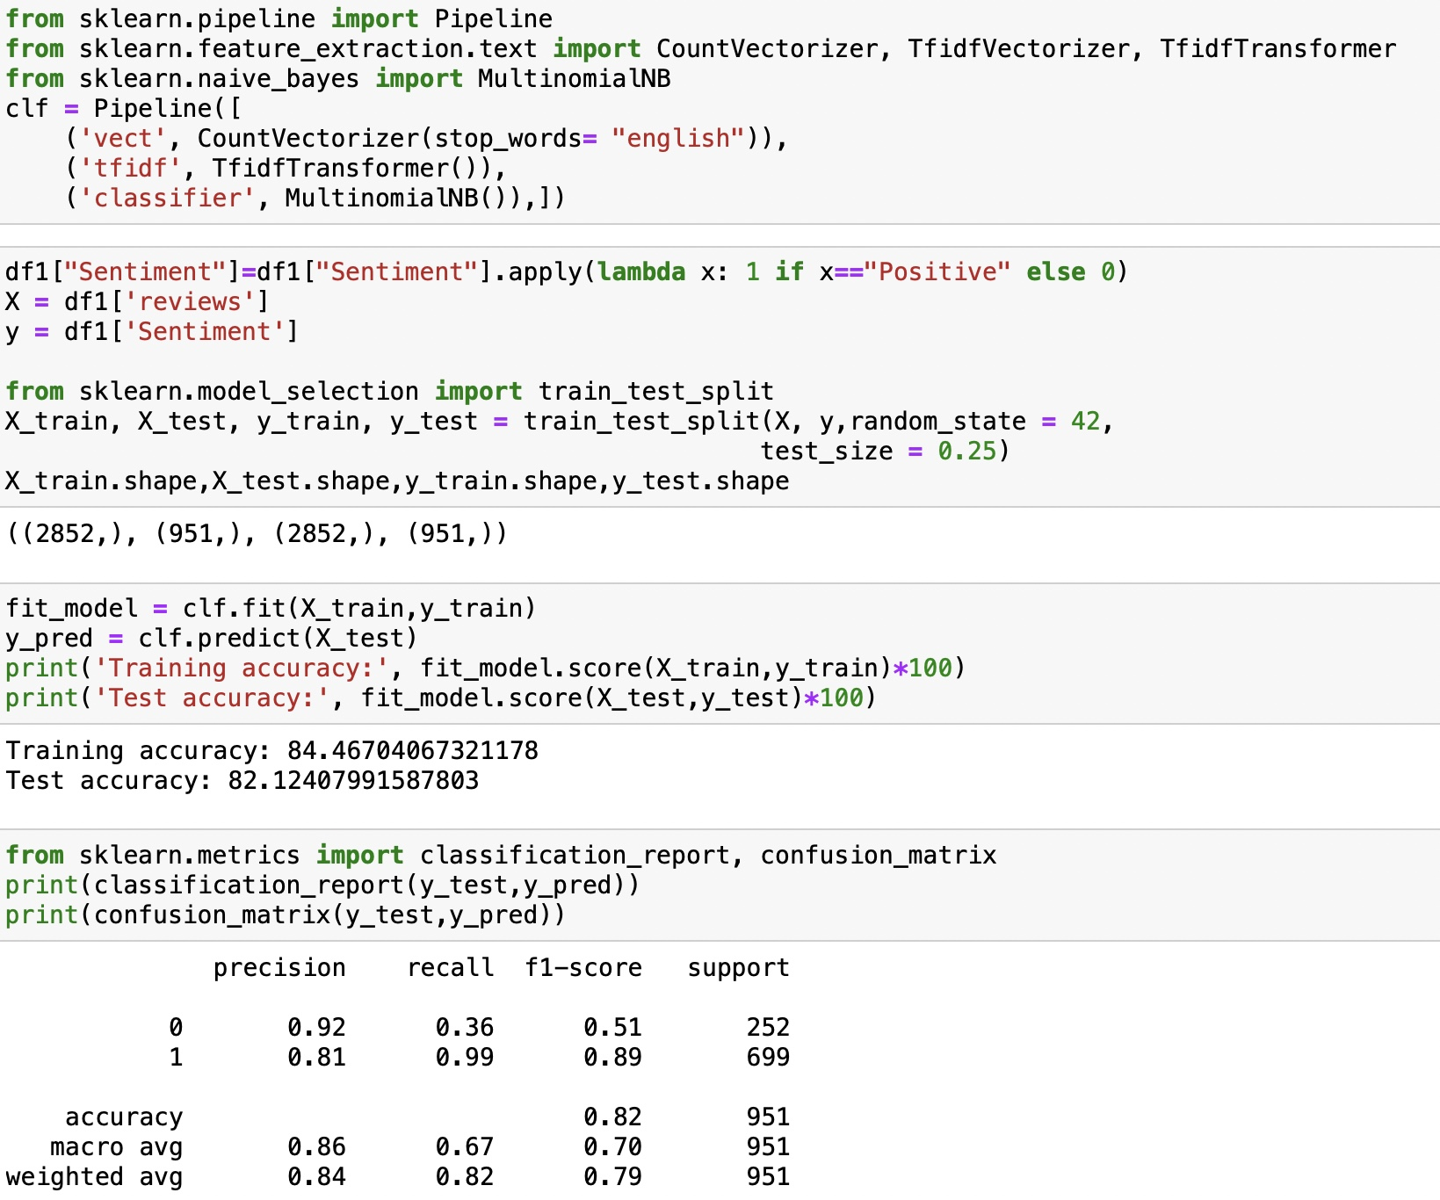
Model Build:
Model - Multinomial Naive Bays

Slide 14
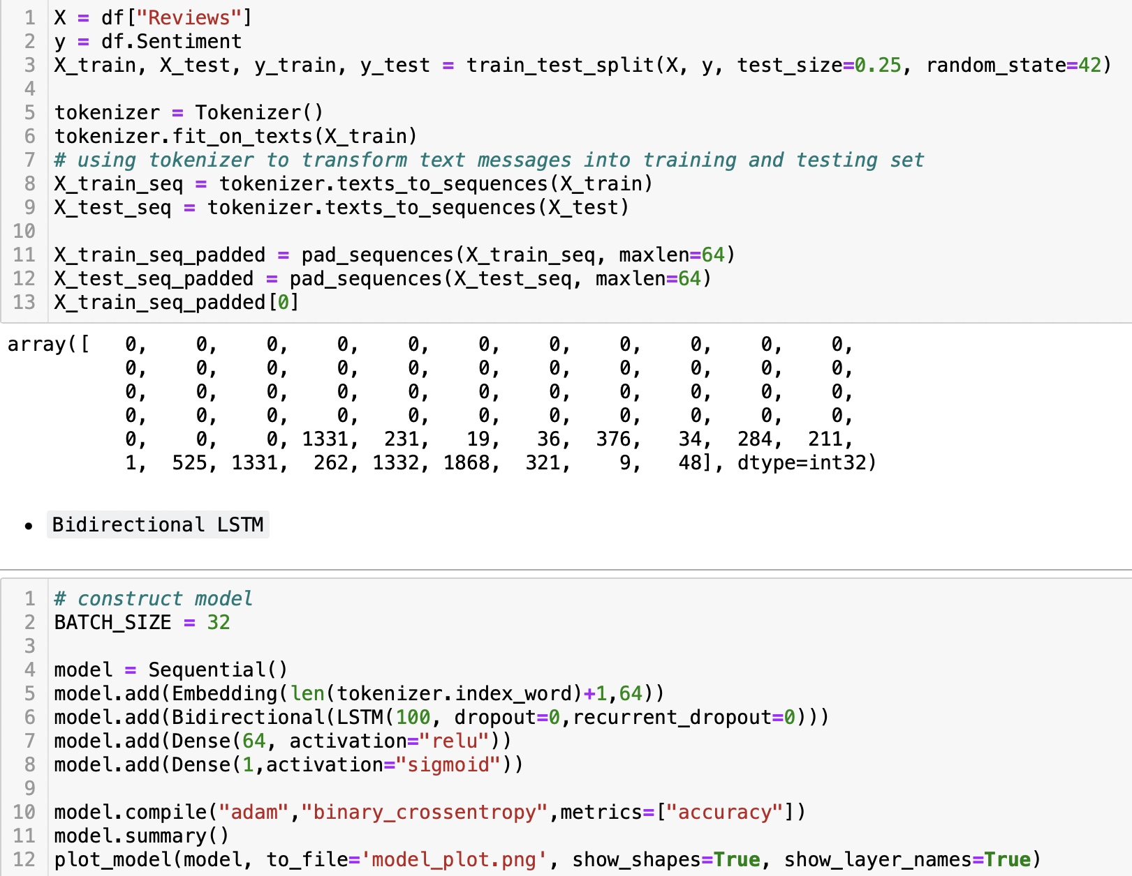
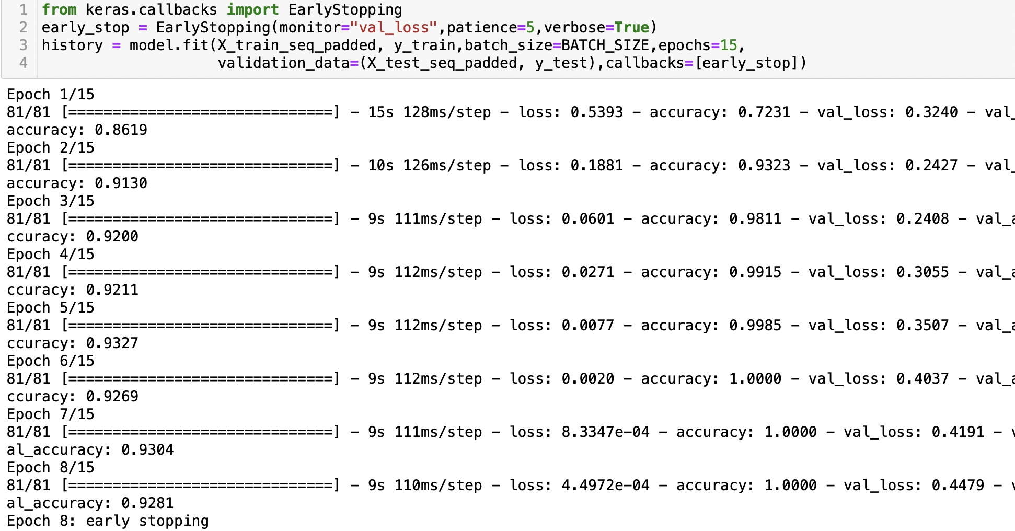
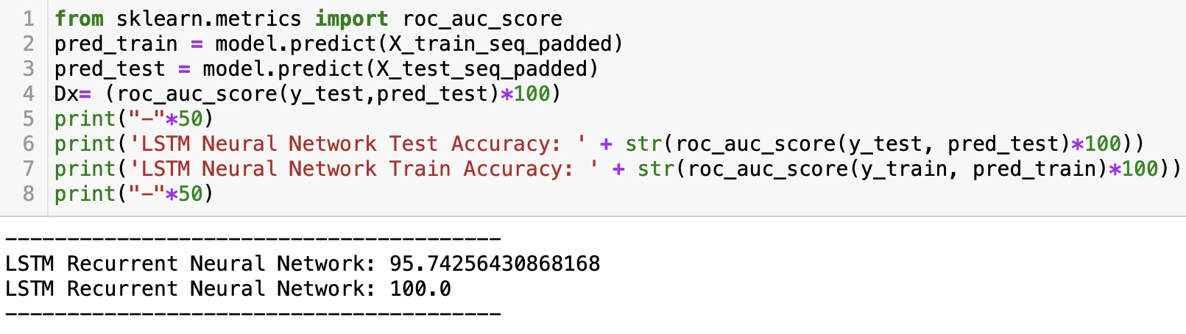
Model Build:
Model - Neural Network

Slide 15
Model results:
sr.no | Algorithm | Training Accuracy | Test Accuracy
1 | Logistic regression | 97.6% | 89.4%
2 | Random forest | 99.1% | 88.6%
3 | Neural Network | 99.5% | 95.7%
4 | Ridge Classifier | 99.2% | 89.2%
5 | Gradient boost | 94.4% | 86.4%
6 | XG boost | 94.1% | 88.3%
7 | SVM(linear) | 92.6% | 88.5%
8 | Naïve bayes | 84.7% | 78.7%
9 | K-fold CV | 82.8% | 80.8%
10 | Decision Tree | 83.8% | 79.3%
As we can see from the above table that Naive Bayes Model has the highest accuracy, so we finalised Naive Bayes model and went for deployment.

Slide 16
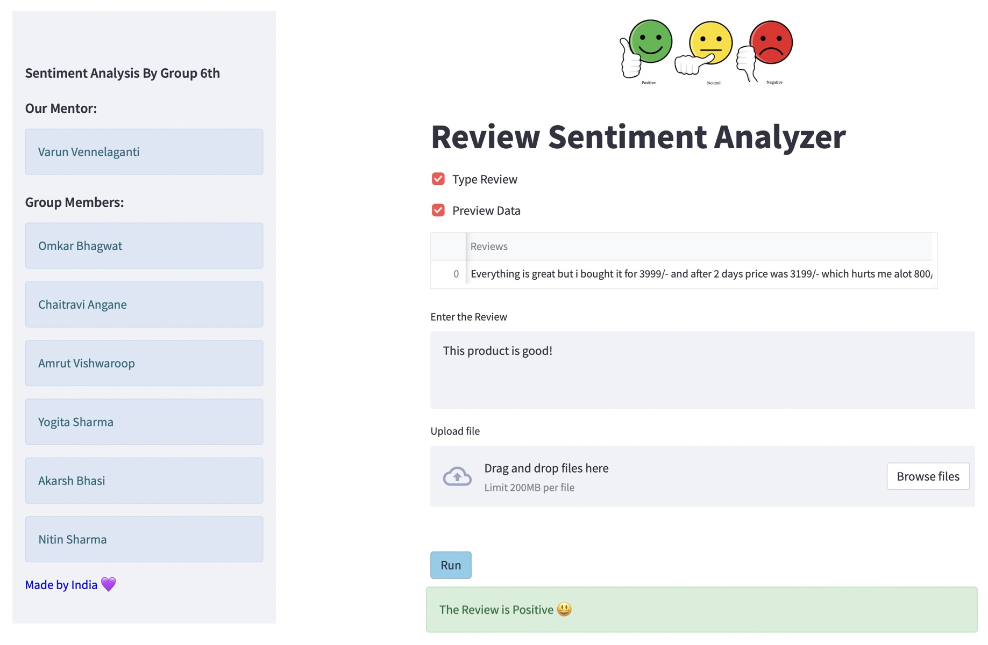
Model Deployment Using Streamlit

Slide 17
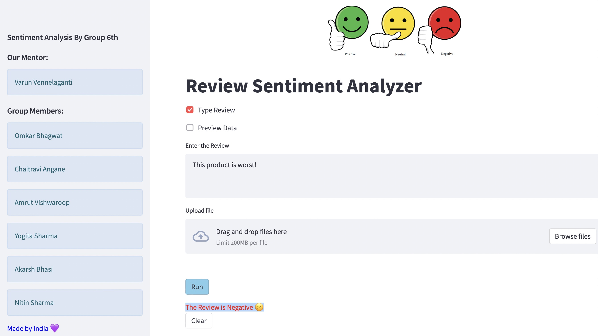
Model Deployment Using Streamlit

Slide 18

Challenges:
First challenge was with the web scraping of data, initially we were unable to extract the reviews from different pages, later after modifying the code we had overcome this problem.
Cleaning of the data was our second big challenge, since in the data there will be emoji's and regional languages, cleaning of this was not an easy task.
Words such as “love” and “hate” are high on positive (+1) and negative (-1) scores in polarity. These are easy to understand. But there are in-between conjugations of words such as “not so bad” that can mean “average” and hence lie in mid-polarity (-75). Sometimes phrases like these get left out, which dilutes the sentiment score
Comparative sentences can be tricky because they may not always give an opinion. Much of it has to be deduced. For example, “This Product is larger than other product.”, the sentence does not mention any negative or positive emotion. So this was also challenging part to us.

Slide 19

Thank you

